Slide 1
Malaria Situation in Zanzibar
Weekly updates as of 15th July, 2024
Week 28

Slide 2
Last week report deliberations
“Week 27”

Slide 3
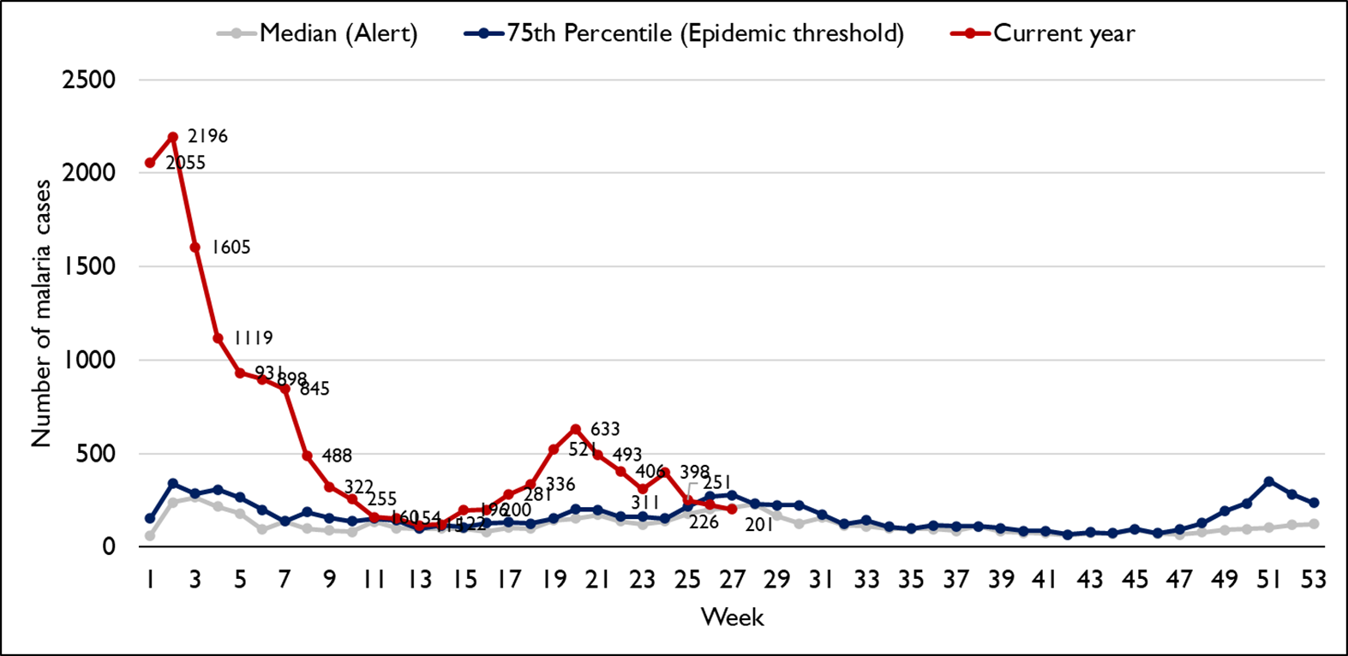
WEEKLY MALARIA CASES IN ZANZIBAR, WEEK 27, 2024

Slide 4
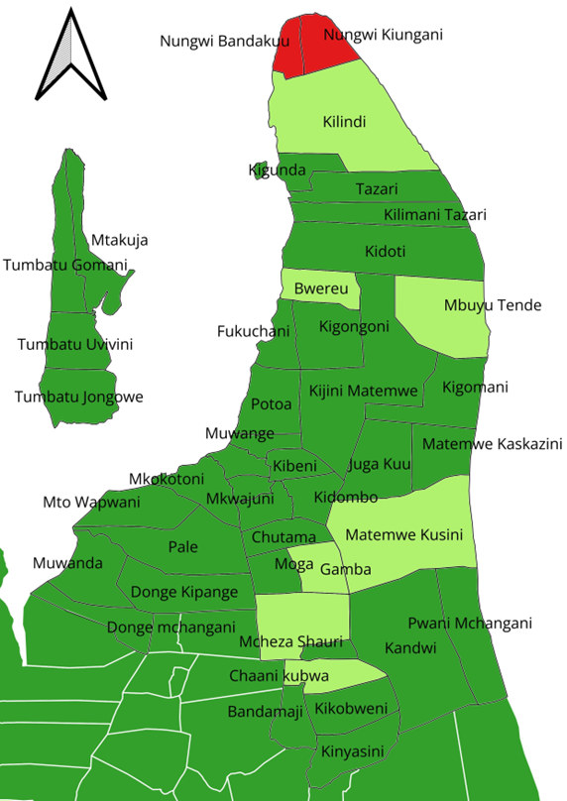
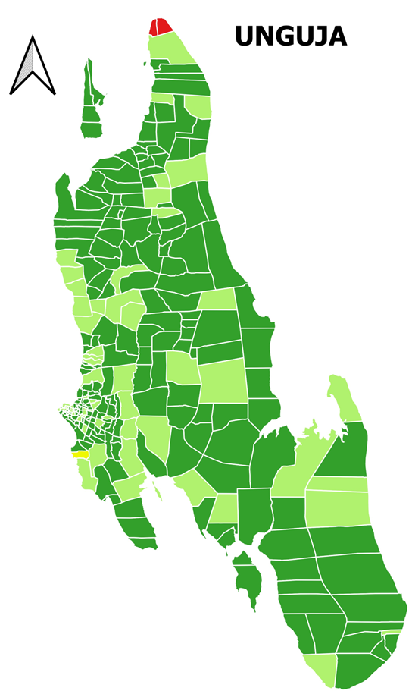
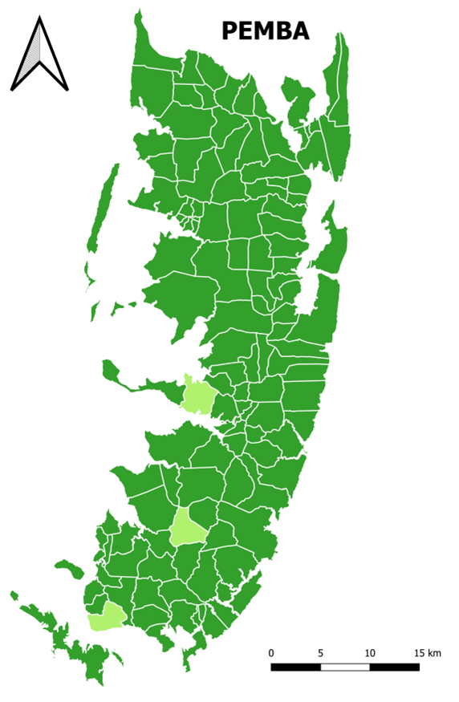
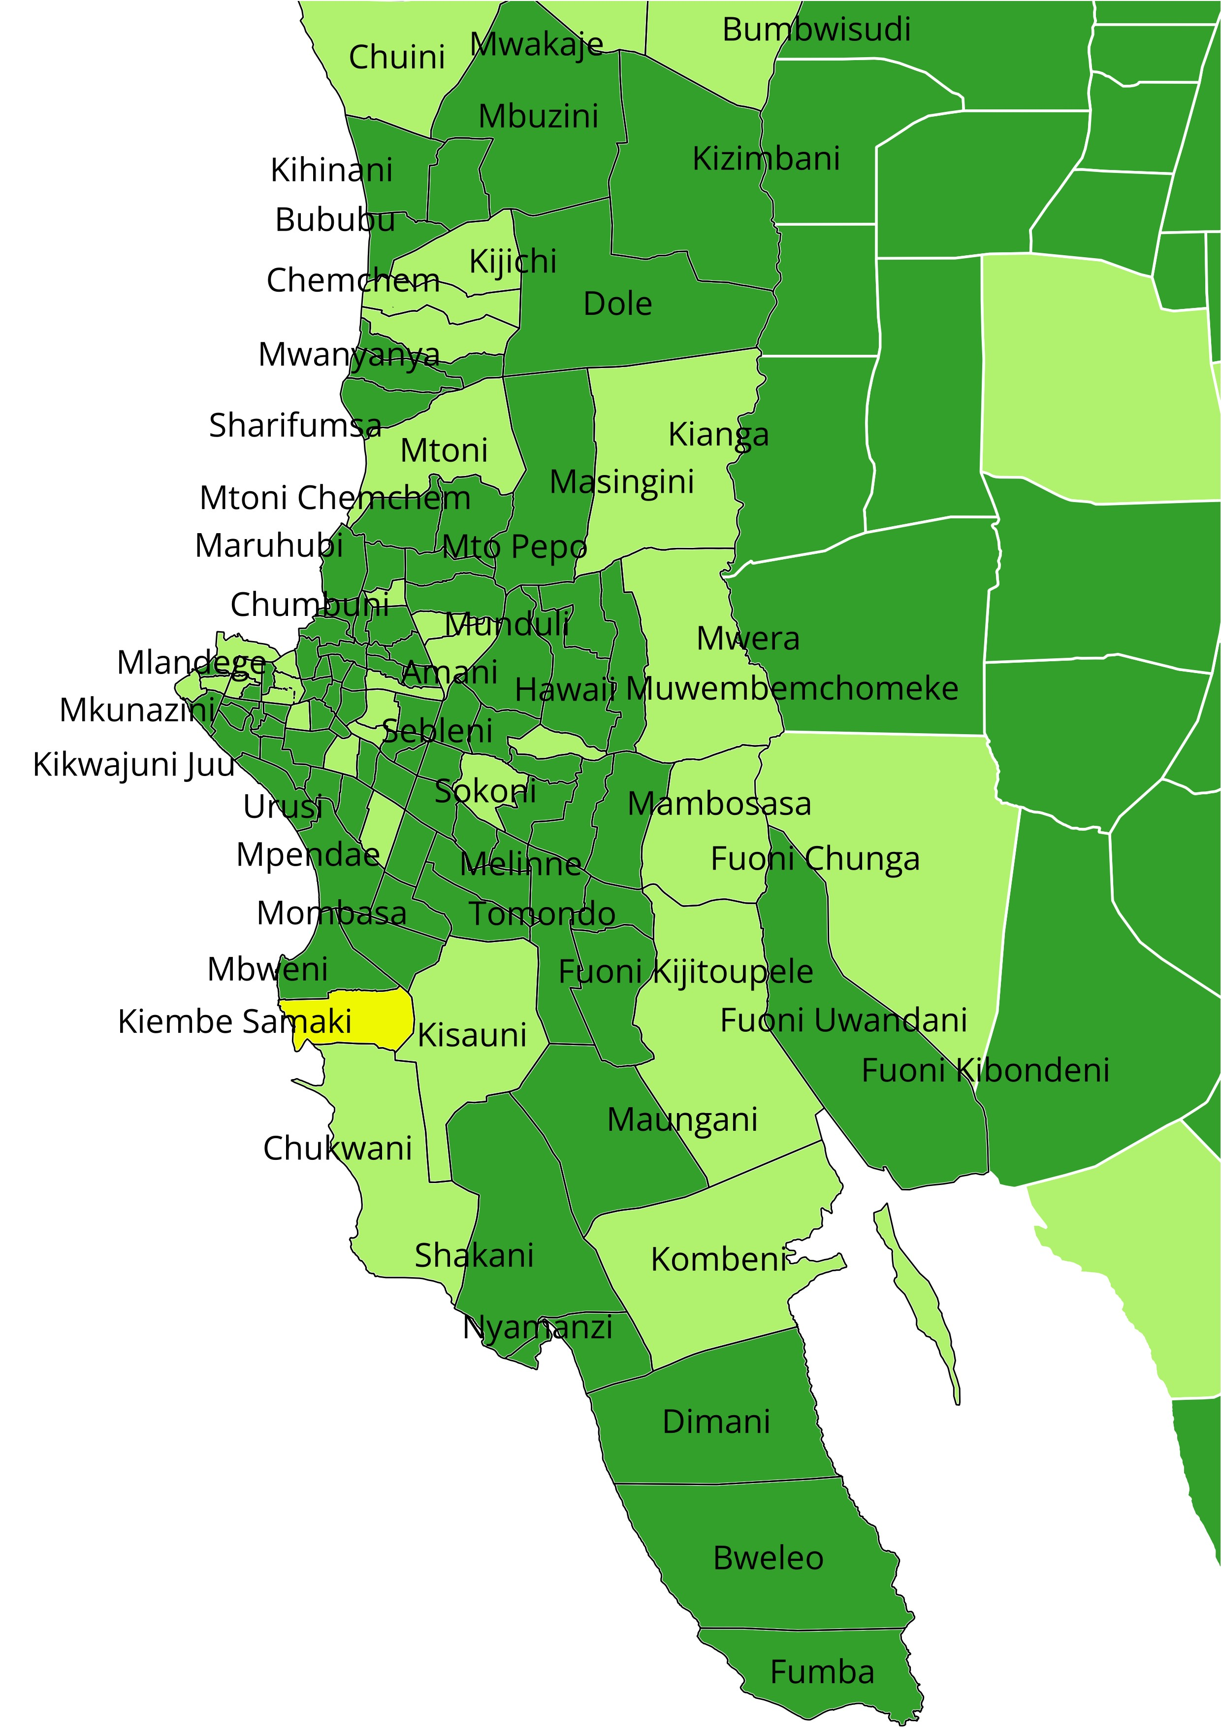
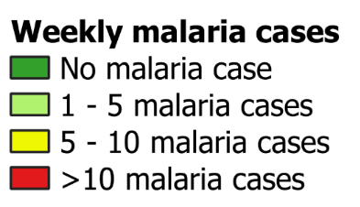
DISTRIBUTION OF LOCAL CASES IN ZANZIBAR - WEEK 27, 2024

Slide 5
INTERVENTIONS CONDUCTED
WEEK 27, 2024

Slide 6
Larvae quality check in Magharibi B
Shehia | Village | Habitat # | Type | Size | # Anopheles | # Culex | implementation
Mbweni | Kisima mbaazi | 6 | Car tires, Water storage (Dumu), pond, Dranage, Hodhi | 10m˃ | 0 | 33 | SBC

Slide 7
Net Assessment in Magharibi B
Shehia | Village | # house visited | # of people | # LLINs/PBO found | % coverage | % of people reported to sleep under nets | % population access to LLINs/PBO (threshold 80%) | % LLINs fit for use
Mbweni | Kisima mbaazi | 33 | 154 | 126 | 163 | 62.2 | 98.4 | 100

Slide 8
Kaskazini A District
Conducted meeting with Shehia leaders to discuss the implementation modalities to address population risk groups (Masai, tour guides) of Nungwi Bandakuu and Nungwi Kiungani.
  DRTs are waiting Shehia leaders to organize the groups in order to respond.
Sensitization meetings to the community of Nungwi Kiungani and Nungwi banda kuu on malaria prevention and importance of early seeking behavior.

Slide 9
CASE MANAGEMENT
Follow up of malaria commodities, admission and deaths to health facilities.
  No health facilities reported antimalaria stock out.
  Admission. 11 cases were reported.
    4 cases admitted from MMH, among of them:
      1 patient was referred from KMKM
      3 cases were self referral.
    2 patients admitted at Ijitimai,
    3 patients were admitted at Kivunge and
    2 patients from Kitogani district hospital.
DEATH: One (1) suspected malaria death reported at MMH in ICU, it was referred from KMKM

Slide 10
Week 28 situation and response plan

Slide 11
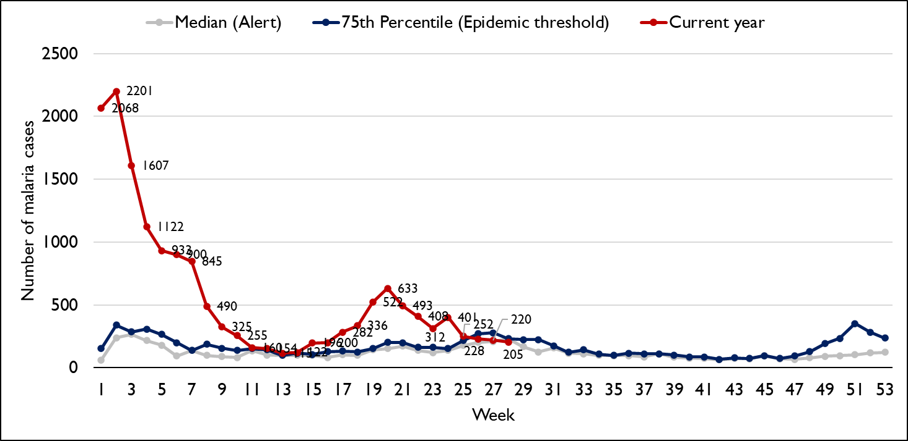
WEEKLY MALARIA CASES IN ZANZIBAR, WEEK 28, 2024
In week 28, there was a decrease of 15 cases notified from the 220 cases that was reported last week
NB: In week 27, it shows an increase of 19 cases that were lately notified from facilities i.e. from 201 to 220 cases

Slide 12
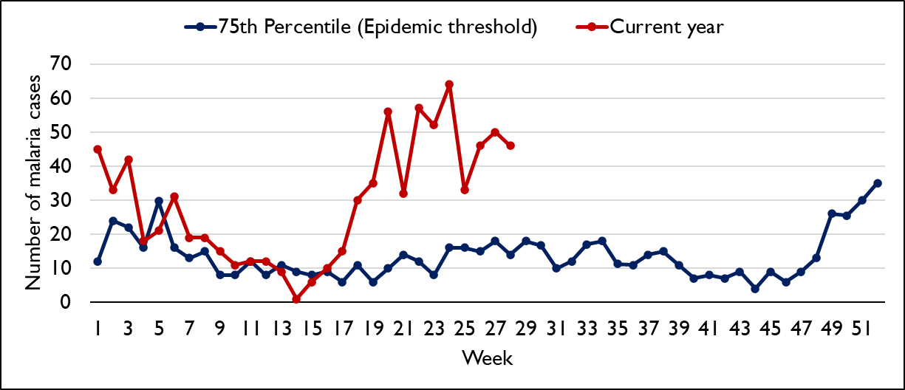
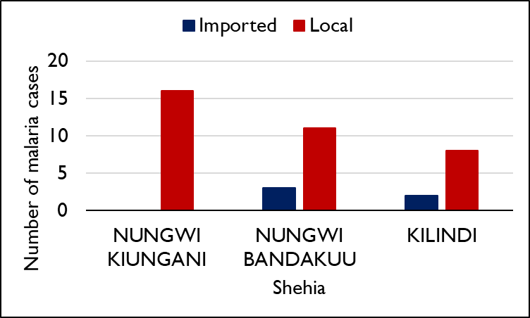
WEEKLY MALARIA CASES IN KASKAZINI A, WEEK 28, 2024
Weekly epidemic threshold
Shehia with ≥ 5 cases

Slide 13
Deepdive
(We use one of the priority shehia e.g Nungwi bandakuu and Nungwi kiungani to understand further)

Slide 14
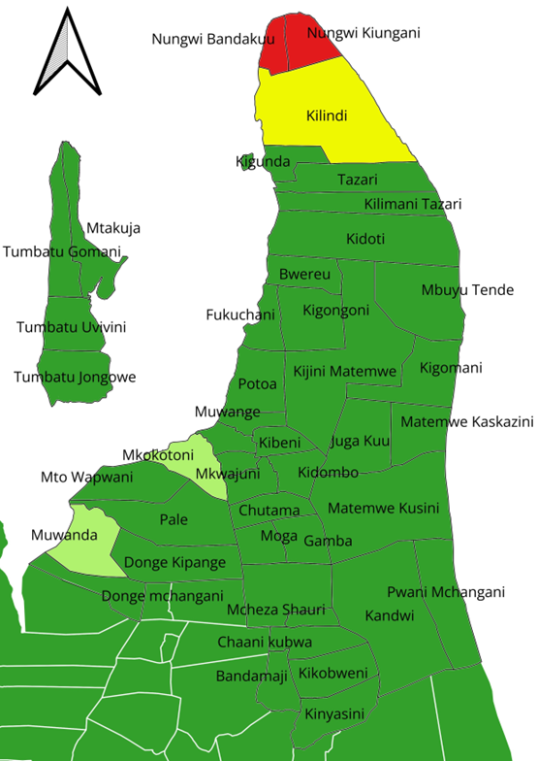
Demographics characteristics in Kilindi, Nungwi bandakuu and Nungwi kiungani, Kaskazini A, week 28
A total of 40 cases were notified, 29 (72.5%) were male.
Age group:
  <5 years – 7 (17.5%)
  5-15 years - 4 (10.0%)
  15-25 years – 16 (40.0%)
  25-35 years – 9 (22.5%)
  35-45 years - 3 (7.5%)
  45+ years – 1 (2.5%)
Case classification- 35 (87.5 %) were local cases

Slide 15
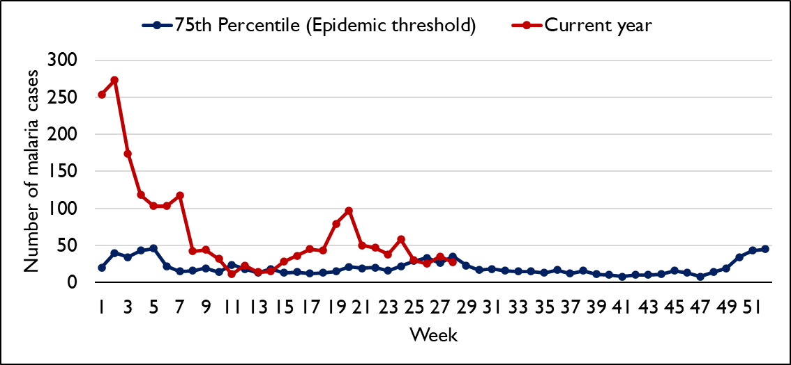
WEEKLY MALARIA CASES IN MAGHARIBI A, WEEK 28, 2024
In week 28, no shehia had 5 or more malaria cases

Slide 16
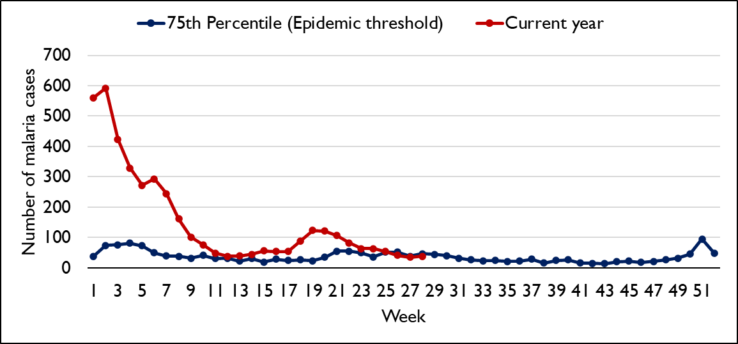
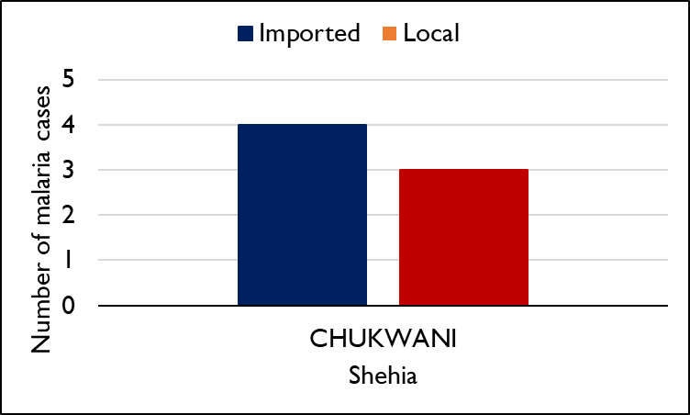
WEEKLY MALARIA CASES IN MAGHARIBI B, WEEK 28, 2024
Weekly epidemic threshold
Shehia with ≥ 5 cases

Slide 17
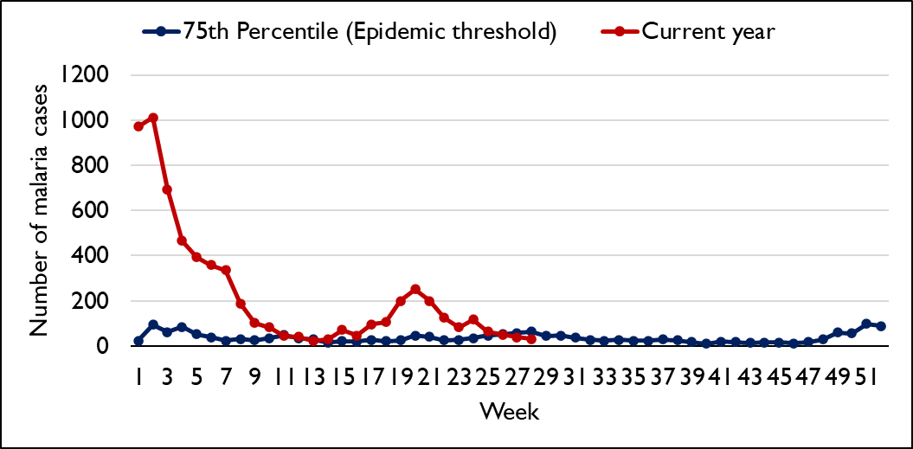
WEEKLY MALARIA CASES IN MJINI, WEEK 28, 2024
In week 28, no shehia had 5 or more malaria cases

Slide 18
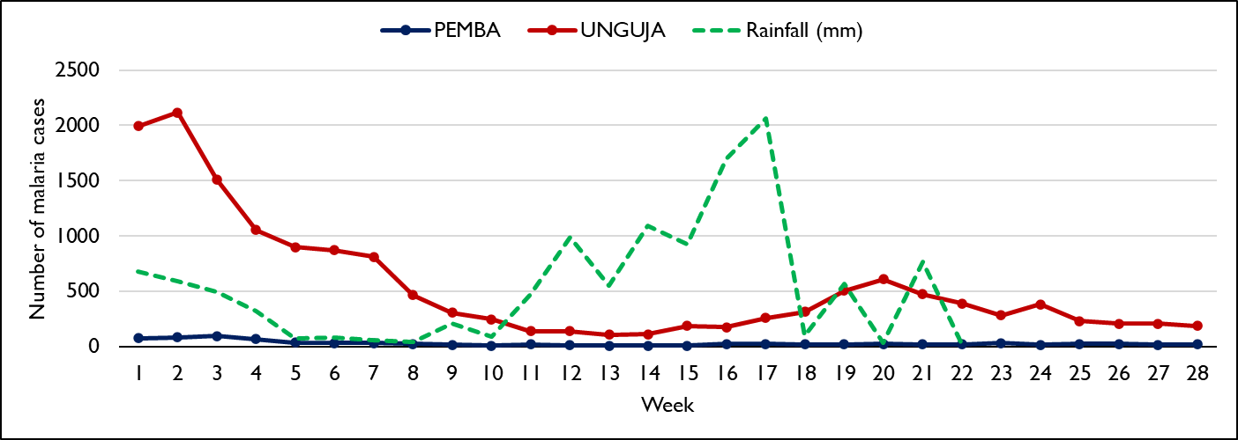
WEEKLY MALARIA CASES IN ZANZIBAR, WEEK 28,2024
Of 797 cases notified in Pemba zone from week 1-28, 251 (31.5%) are in Wete, 242 (30.4%) in Chakechake, 208 (26.1%) in Micheweni and 96 (12.0%) in Mkoani districts.
Of 15,188 cases notified in Unguja zone from week 1-28, 6,217 (40.9%) are in Mjini, 4,195 (27.6%) in Magharibi B, 1,961 (12.9%) in Magharibi A, 930 (6.1%) in Kati, 820 (5.4%) in Kaskazini A, 609 (4.0%) in Kaskazini B and 456 (3.0%) in Kusini districts.
Notes:
Present weekly disaggregate into local and imported

Slide 19
MALARIA CASES IN PEMBA DISTRICTS, 1st Jan – 15th July, 2024
District | Total Number of cases | # of cases in last 4 weeks
 |  | wk25 | wk26 | wk27 | wk28
CHAKECHAKE | 242 | 6 | 9 | 4 | 9
MICHEWENI | 208 | 5 | 4 | 2 | 1
MKOANI | 96 | 1 | 7 | 3 | 1
WETE | 251 | 10 | 2 | 6 | 7
Grand Total | 776 | 22 | 22 | 15 | 18

Slide 20
MALARIA CASES IN UNGUJA DISTRICTS, 1st Jan to 15th July, 2024
District | Total # of Cases | # of cases last 4 weeks
 |  | wk25 | wk26 | wk27 | wk28
KASKAZINI A | 820 | 33 | 46 | 50 | 46
KASKAZINI B | 609 | 11 | 8 | 12 | 7
KATI | 930 | 24 | 16 | 17 | 29
KUSINI | 456 | 15 | 20 | 18 | 9
MAGHARIBI A | 1,961 | 30 | 25 | 35 | 27
MAGHARIBI B | 4,195 | 53 | 41 | 35 | 38
MJINI | 6,217 | 64 | 50 | 38 | 31
Grand Total | 15,188 | 230 | 206 | 205 | 187

Slide 21
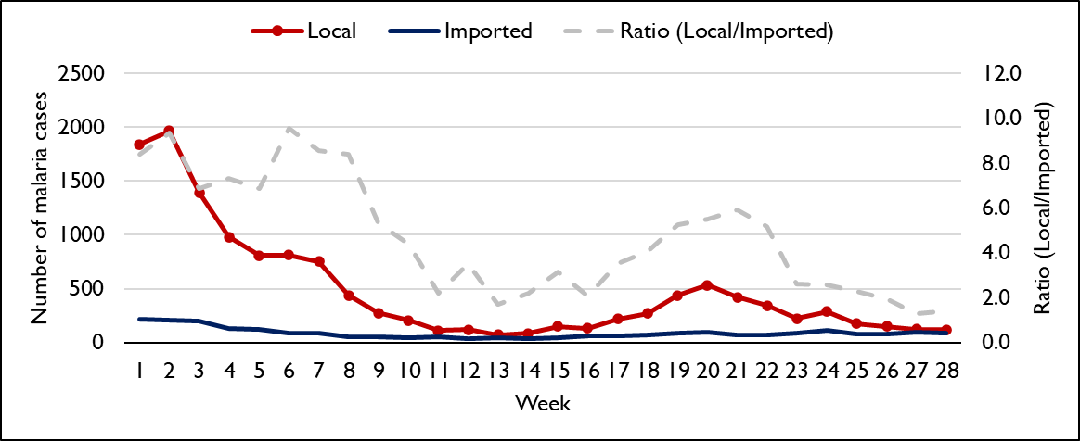
DAILY MALARIA CASES IN ZANZIBAR, 2024
Notes:
Make this weekly per month, remove the ratio but add thresholds lines

Slide 22
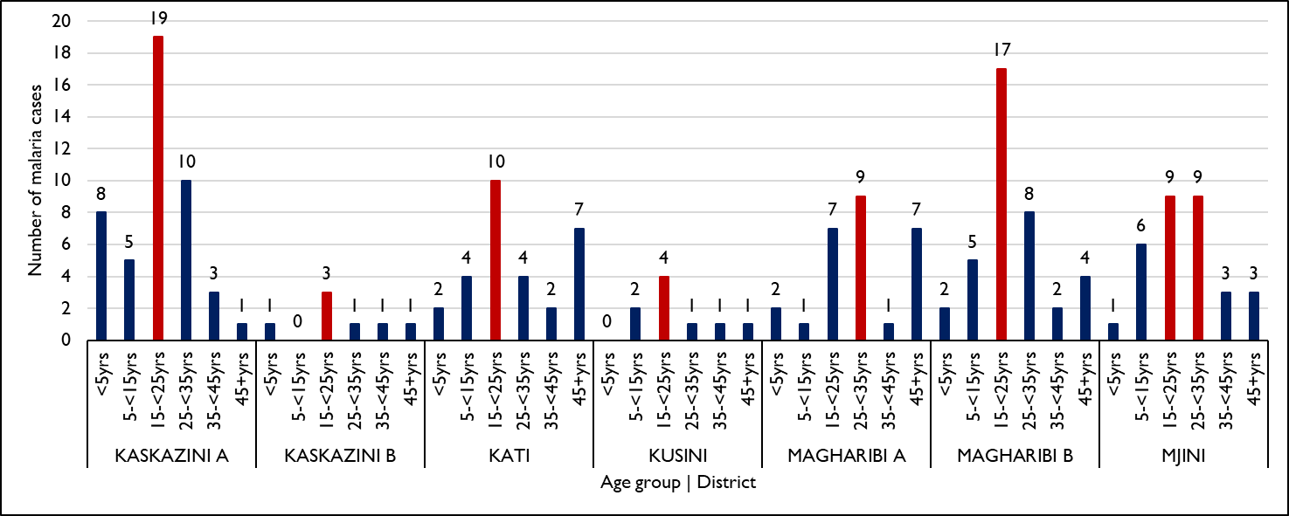
DEMOGRAPHIC SUMMARY BY AGE GROUP - WEEK 28, 2024
Notes:
Make age in order from <5 to adults…

Slide 23
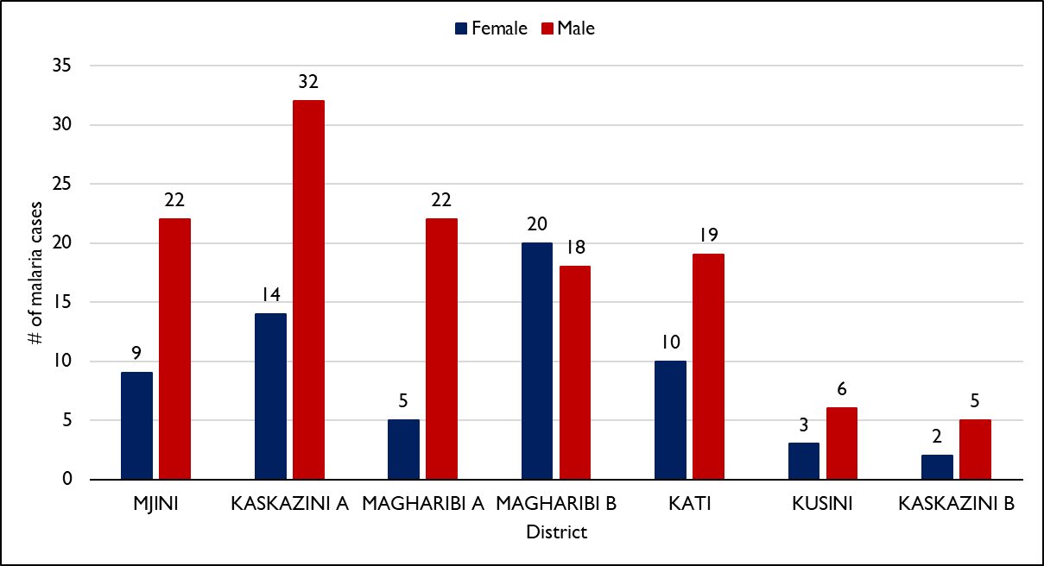
DEMOGRAPHIC SUMMARY BY SEX, WEEK 28, 2024

Slide 24
Response plan for week 28

Slide 25
Kaskazini A (Nugwi banda kuu and Nungwi Kiungani)
Conduct fMDA to most affected groups (Masai and tour guiders) after receiving feedback from the Shehia leaders on when and where to get the targeted population.
ACD to Nugwi camp school after having reported three local cases

Slide 26
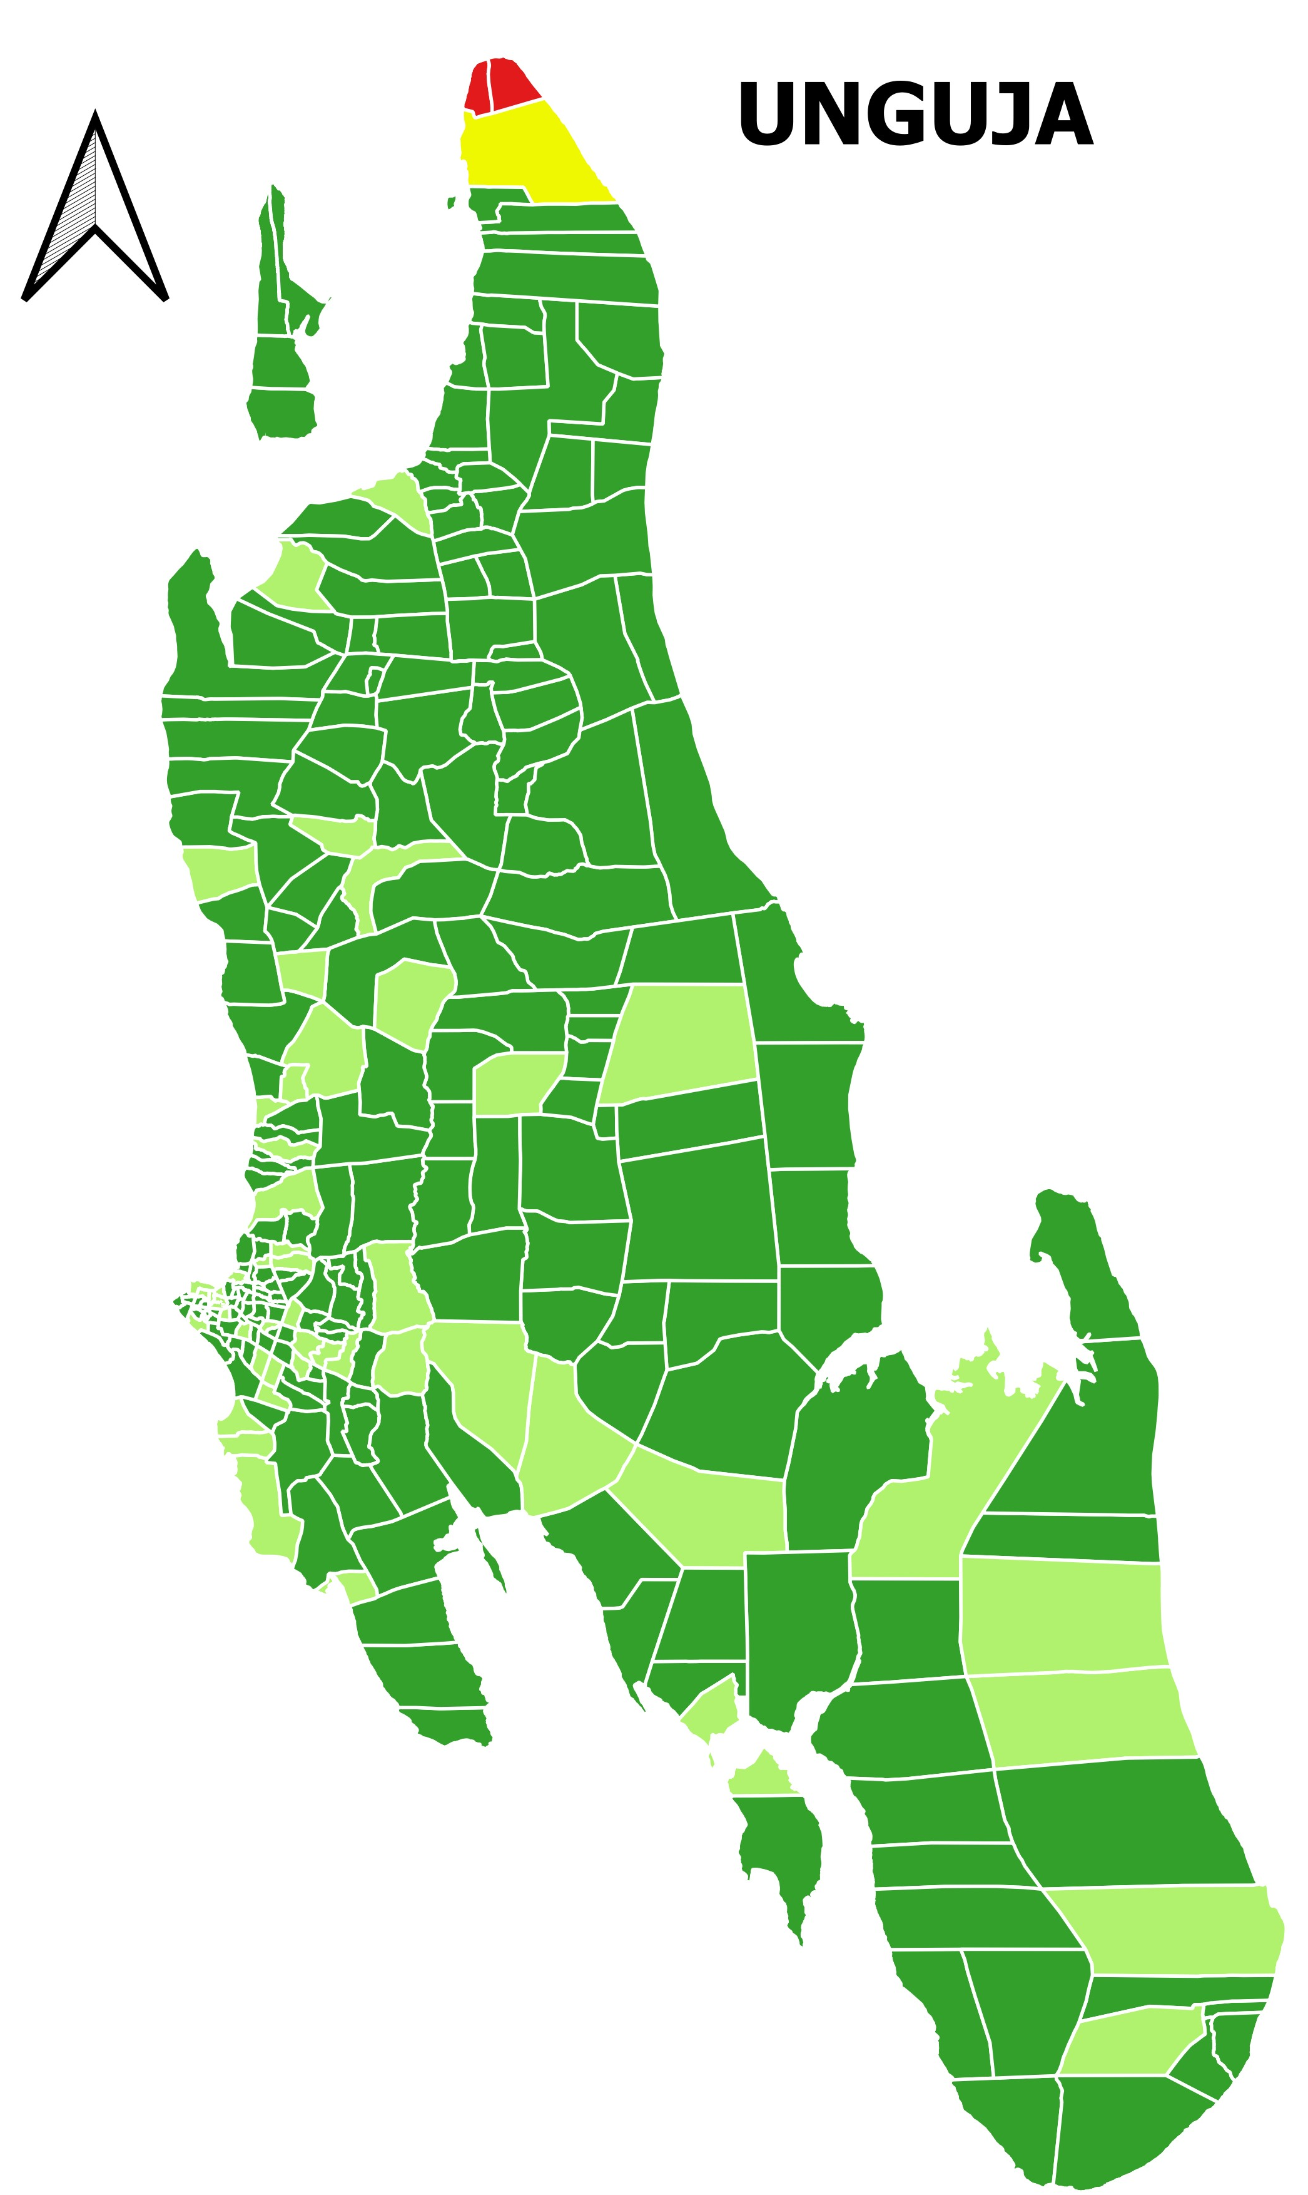
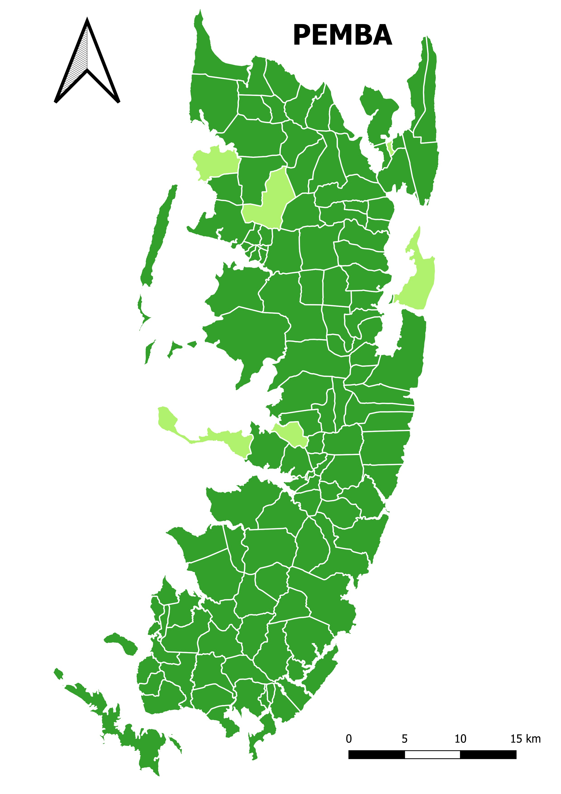

DISTRIBUTION OF LOCAL CASES IN ZANZIBAR - WEEK 28, 2024

Slide 27
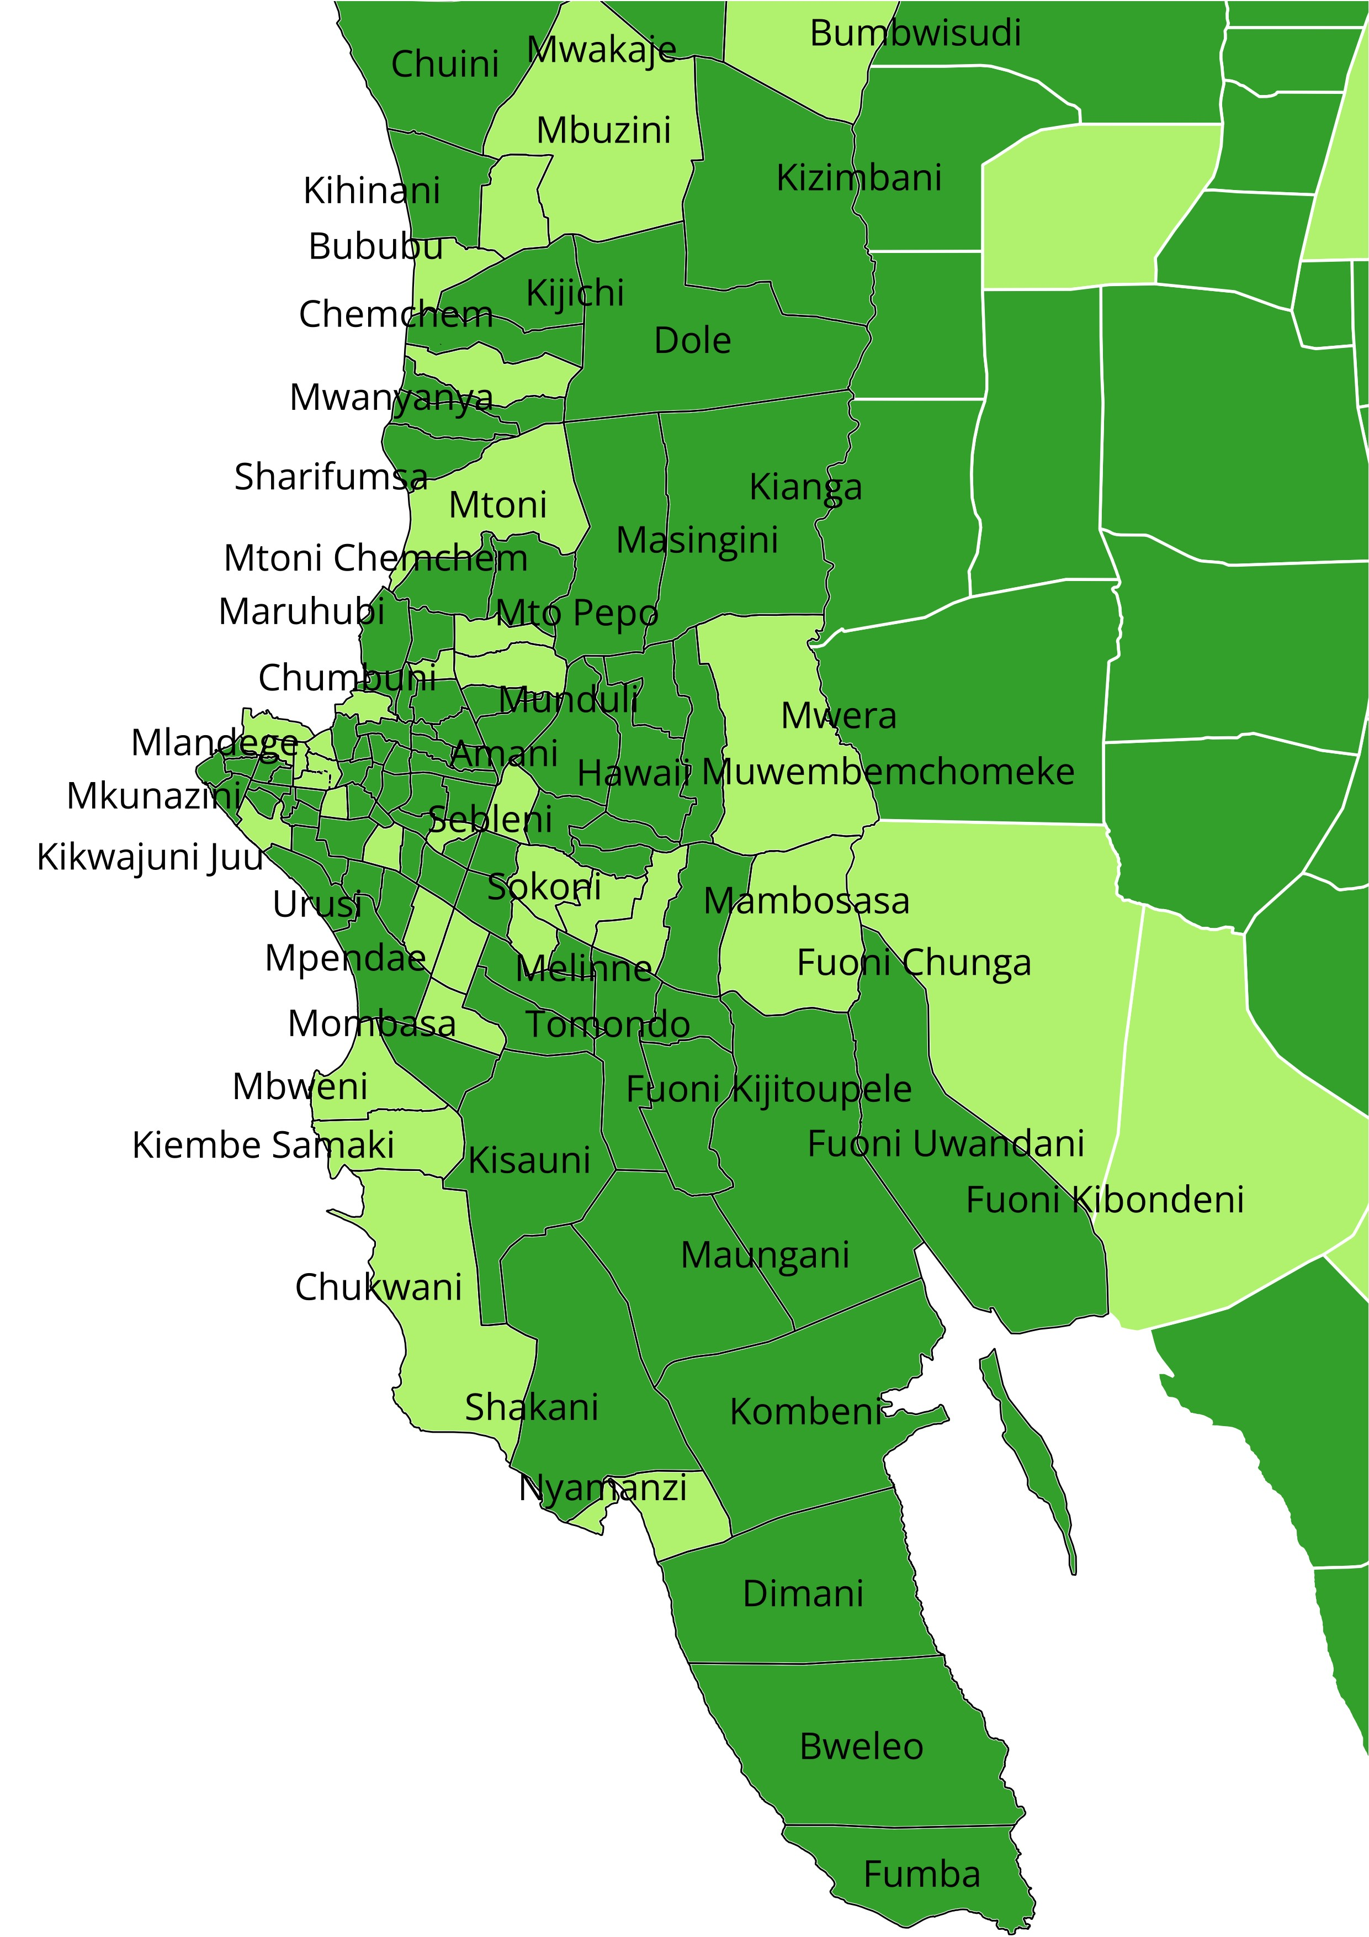
SHEHIAS WITH LOCAL CASES IN MJINI MAGHARIBI REGION
WEEK 27 vs 28, 2024
Week 27
Week 28

Slide 28
Key takeaways and recommendations
Despite the general case decrease in Zanzibar, yet Kaskazini A has persisting high number of cases that are above the district threshold.
  ZAMEP to intensify further responses in the area, including further SBCC campaigns to address inhouse breeding habitats (covering water pots, toilet facilities, open eaves), and conduct further entomological foci investigation and response.
Predominance of male cases in Kaskazni A could suggest some occupational based risk contributing to transmission. Thus appropriate search of high risk groups with appropriate targeted intervention is recommended.
  An integrated approach where all thematic units work as a team to address Kaskazini A i.e. all units at the same time and place, is highly recommended to make this recommendation achievable.

